Slide 1
Demand Forecast for SKU
Aditya Bhattar

Slide 2
Problem Statement
Given 3 years of sales data of a Stock keeping unit for a retail store, forecast the demand for the final 12 weeks of year 2019

Slide 3
Potential Business Insights
Forecasting demand for a SKU can play an integral role in inventory management.
On the basis of demand, inventory of stock can be maintained.
Also helps in identifying buying behavior and busy periods.
Can identify seasonality and trends in sales and manage inventory accordingly.

Slide 4
Features of the Dataset
Sales data provided on a weekly basis for 145 weeks for the period from 1st January, 2017 to 8th October 2019
Predict sales figures for the final 12 weeks of 2019 from 15th October 2019 to 31st December 2019

Slide 5
Evaluation Metric
The evaluation metric for this problem is Mean Absolute percentage error (MAPE)
Mean absolute percentage error is defined as sum of the absolute difference between actual and predicted value given as a percentage of the actual value
From a business point of view, you would want the MAPE to be as low as possible, which would indicate that you are able to predict the sales outcome accurately.

Slide 6
Feature Engineering

Slide 7
Features extracted from existing data
Month and year extracted from date provided.
The number of the weeks for each month was calculated. For ex – If January has 5 weeks, than the week no corresponding to that particular date was identified.
For most of the weeks, around 1500 – 2500 units were sold. However for a period of 5 weeks in 2018 starting from 26th November, sales volumes were significantly higher, going up to 10000 units sold. These weeks were identified as having some special offer on the product and were treated accordingly.
Assuming the retail store is located in India, the monthly inflation rate from 2017 to 2019 was added as a feature. Source for inflation rates –
https://www.inflation.eu/inflation-rates/india/historic-inflation

Slide 8
Exploratory Data Analysis

Slide 9
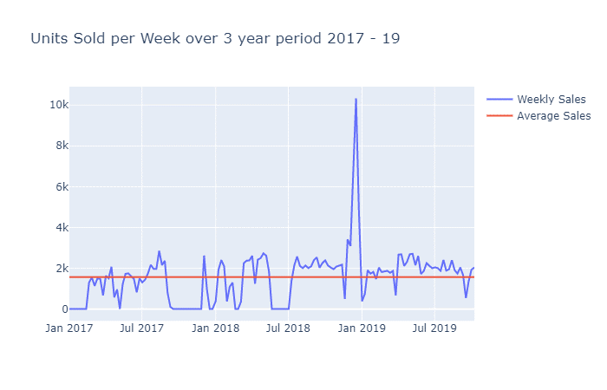
Weekly sales from 2017 to 2019
Sales mostly hover around to 2k mark for most of the weeks.
28 weeks had sales of zero units sold.
The sales increase significantly for the final 5 weeks of 2018, peaking at 10000 units sold in the week of 17th December.
Average sales over the whole period is 1563 units. This is being affected by the weeks where zero units were sold.

Slide 10
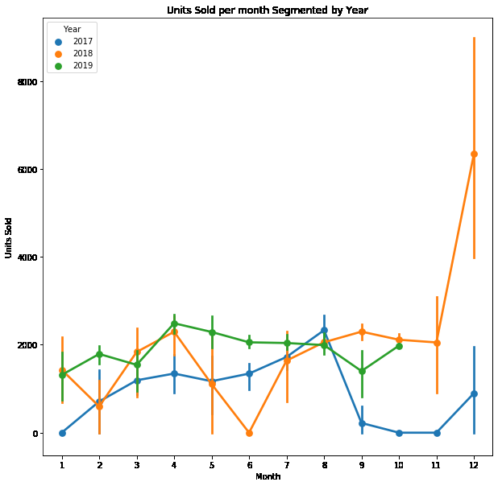
Monthly sales by Year
For year 2017, sales show an increasing trend up to August, before showing a sharp decline for the final 4 months of the year.
In year 2018, sales are much less predictable, with no discernible pattern visible. Sales dip in June, but increase significantly in the final few weeks.
2019 mostly shows stable sales throughout the year, with a slight dip in March and September.

Slide 11
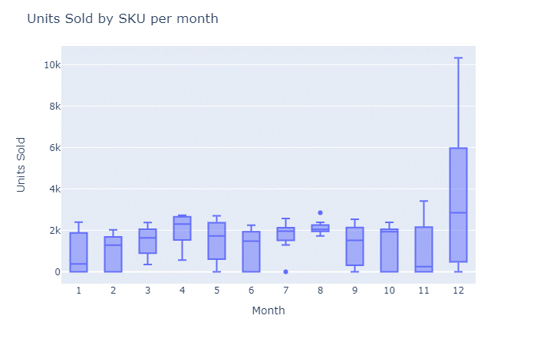
Boxplot of Sales by Month
The following graph shows that there are very few outliers for the sales.
Even for the month of December, which has 10k sales for one week, it still cannot be considered as an outlier as per the boxplot.
Since there are only two outliers, sales data for all weeks was included as is.

Slide 12
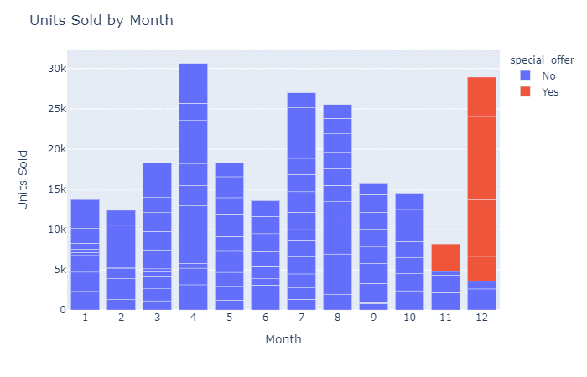
Units Sold by Month
Highest sales are observed in the months of April, December, July and August.
November and February show the least amount of sales.
This shows an opportunity to offer some discount or offer during these months.
As can be seen, the offer provided in November makes up half of the sales for that month over the two years.
Figures for the month of December are particularly high due to the special offer being provided on products during 2018.

Slide 13
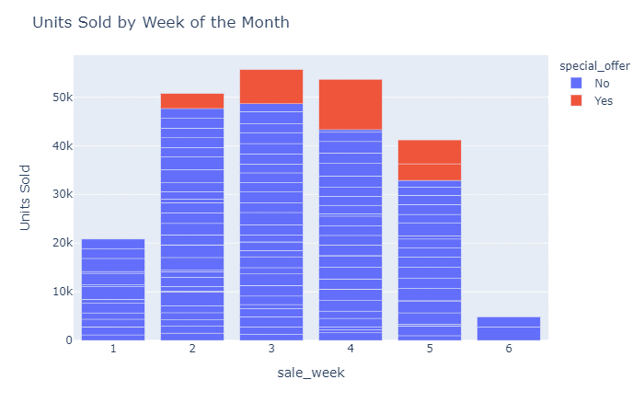
Units sold by week of the Month
Sales usually peak around the 3rd and 4th week of the Month.
The 6th week is actually not always a full week, so can be ignored.
Sales are less in the first week of the month. This represents an opportunity to offer some type of discount during the first week of every month to help increase sales.

Slide 14
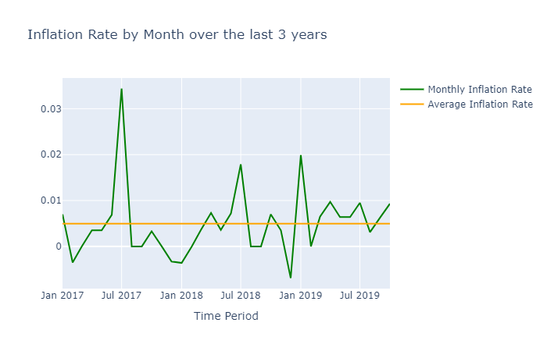
Inflation
Monthly Inflation ranges from -0.005% to 0.35% over the 3 year period being observed.
Average inflation per month over the 3 year period is around 0.005%.

Slide 15
Modelling and Results

Slide 16
Time Series Modelling - ARIMA
The first model used to make sales predictions is ARIMA time series model.
ARIMA (Auto Regressive Integrated Moving Average) forecasts values based on own past values, lags and forecast errors.
ARIMA models are a good starting point for Time Series analysis, which can then be extended to Seasonal ARIMA models.
Data has been divided into train and test set. Test set consists of sales output for last 10 weeks for which we have data. (6th August 2019 onwards).

Slide 17
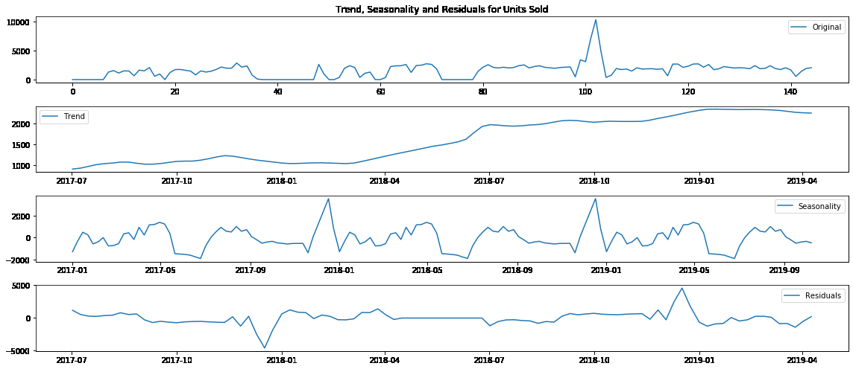
Trend, Seasonality and Residuals
Sales mostly show a positive trend over the three years.
Sales show bi-yearly seasonality, with sales dipping around the mid-year mark and reaching their peak at the year end.
This can potentially be captured by a seasonal ARIMA model using a 6 monthly seasonal variation period.

Slide 18
Stationarity of Time-Series
For checking Stationarity, Augmented Dick – Fuller test has been used with a confidence level of 95%.
The p-value for the time-series was 0.000002, indicating it is a stationary time series, hence no transformation or differencing was required on the data.
Time series model was applied on the dataset as is, without any transformation.

Slide 19
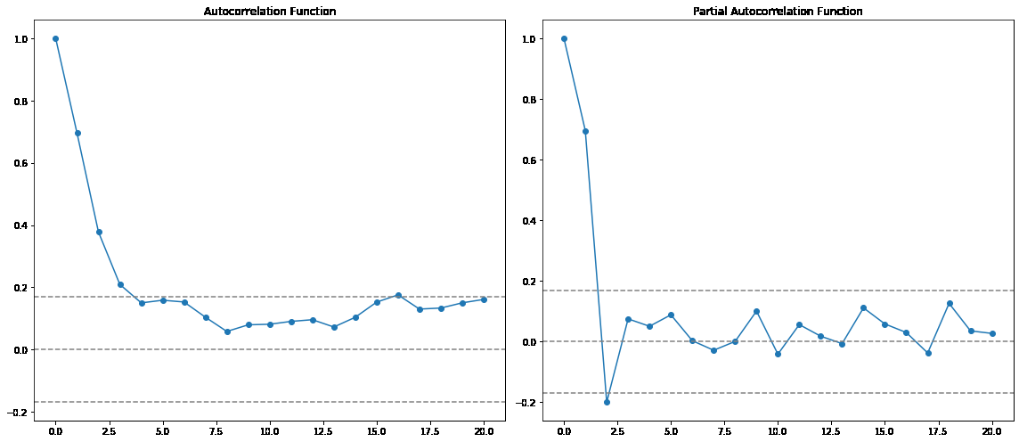
Determining value for p and q
The following graph shows that the value for both p and q should be less than 2.5, so took the value for p and q as 1.
p and q refer to the lagged terms to be taken for AR and MA respectively.

Slide 20
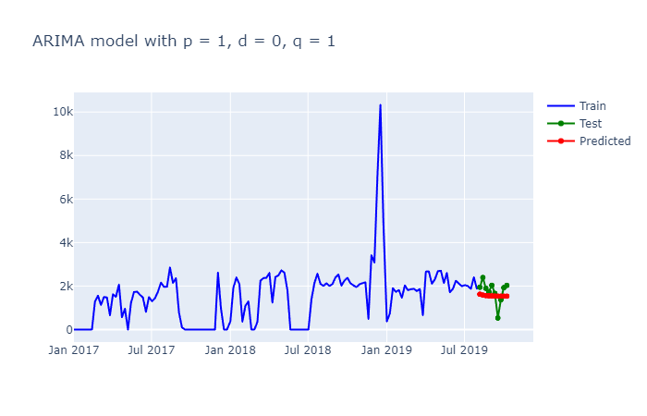
Forecast with ARIMA model
As can be seen, the ARIMA model has not been able to predict the sales output correctly.
It has not been able to capture the dip in sales post August 2019.
MAPE using ARIMA model is 35.48%

Slide 21
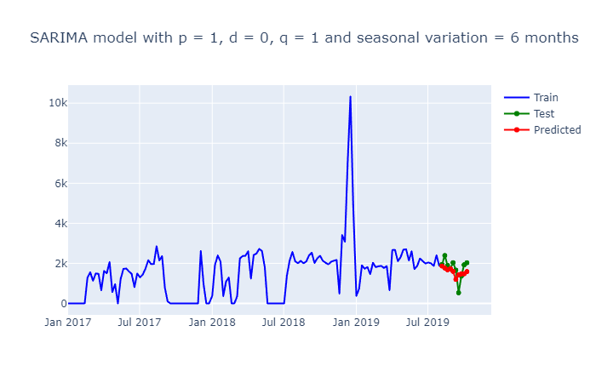
Forecast Using SARIMA Model
SARIMA model has given a better accuracy as compared to ARIMA, being able to capture some seasonality of the sales data provided.
It has been able to capture the dip in sales to some extent for the last 10 weeks.
MAPE using SARIMA model is 31.03%. Still room for improvement.

Slide 22
Ensemble Models – Random Forest and XGBoost
For ensemble models, I have chosen Random Forest and XGBOOST algorithm.
Ensemble techniques usually require more data points to learn better on the data, so results may vary a lot from actual output.
Results have been shown after undertaking hyperparameter tuning of the models.
For prediction, the week, month, year, inflation and whether special offer is provided or not have been used as features for modelling.
In the validation set, it has been assumed that the special offer will be provided, similar to 2018, for the last 5 weeks of the year.

Slide 23
Results
The MAPE for Random Forest is 57.48%
The MAPE for XGBOOST is 47.26%
More features are required to allow the models to learn better on the data
More data would also help in this regard. Instead of last 3 years data, last 5 or 10 years data should be collected, if possible at a more granular level.

Slide 24
Comparison of Model Results
The following table shows the results for all the four models.
As evident from the predictions, only Random Forest has been able to capture the special offer provided in the last 5 weeks, as can be viewed in the uptick in sales.
XGBoost predictions are mostly within a range of +-400, showing the trees have not grown to much depth.
ARIMA and SARIMA models are actually showing a decline in sales as we move further along the year.

Slide 25
Conclusion and Next Steps
None of the 4 models used did a very good job in terms of capturing the essence of the data.
Need to undertake more feature engineering to better predict results.
Tuning of time series models can be done to better predict outcomes.
If special offer is to be given, Random Forest models can be used, as they are able to differentiate between weeks with no offer and weeks where offer has been provided.
May need to try simpler models as number of datapoints is less.

